Slide 1
Insights to Telangana Government Tourism Department
By Zain ul Hassan

Slide 2
Agenda
Overview
Key Areas
Recommendation
Problem BreakDown
Questions / Insights
Dashboard

Slide 3

Overview
Telangana
Leading state
Published Tourism Data
Want to Improve Tourism Revenue
Hired Data Analyst
Identify the Trends
Establish the Model
Developed the Insights
Share the Recommendations
Insights Help to Improve Administrations
Improve the Revenue

Slide 4
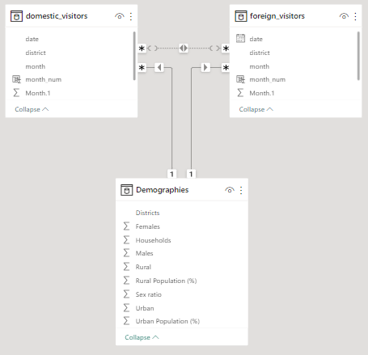
Problem Break Down
Data Modelling
Foreign Visitors Growth
Foreign Visitors
Revenue Prediction
Total Visitors
Domestic Visitors Growth
Domestic Visitors
Revenue Prediction

Slide 5
Key Areas
Future Revenues And Tourists Projections
Top Performing Districts
In terms of Visitors
Crucial segments
Domestic to Foreign tourists ratio
Compounded Annual Growth Rate
Monthly Trend of Visitors over Different Years

Slide 6
Questions and Insights

Slide 7
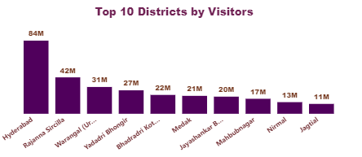
Question 1:
List down the top 10 districts that have the highest number of visitors overall (2016-2019)
Insights
Hyderabad has the highest number of Visitors approximately 84M

Slide 8
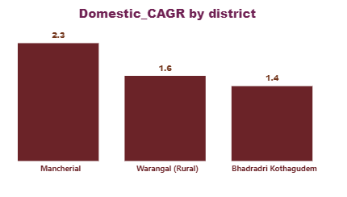
Question 2:
List down the top 3 districts based on compounded annual growth rate(CAGR) of visitors between (2016-2019)
Insights
Mancherial, Warangal, and Bhadradri are the Top 3 Districts in terms of COGR

Slide 9
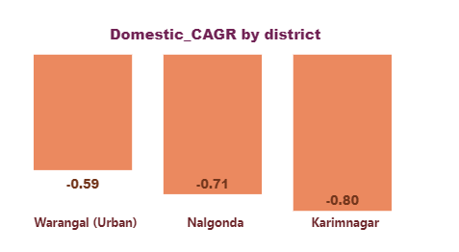
Question 3:
List down the bottom 3 districts based on compounded annual growth rate(CAGR) of visitors between (2016-2019)
Insights
Karimnagar has the Lowest CAGR in all Districts

Slide 10
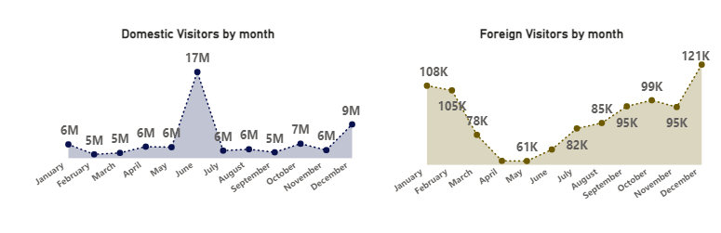
Question 4:
What are the peak and Low months for Hyderabad based on the data from 2016 - 2019 for domestic visitors and foreign visitors?
June and December for domestic visitors while December to February for Foreign Visitors are Peak months in Hyderabad due to vacations
February , March and April, May are low months for visitors due to working is at peak in these months
Insights

Slide 11
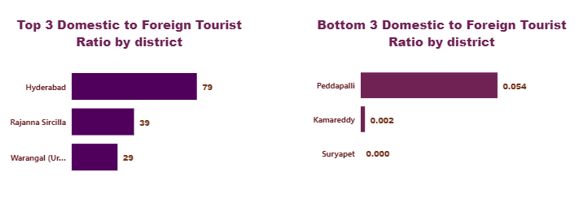
Question 5:
Show the top and bottom 3 districts with domestic to foreign tourist ratio
Insights
Hyderabad has the highest domestics to foreign visitor ratio while Suryapet has the Lowest ratio

Slide 12
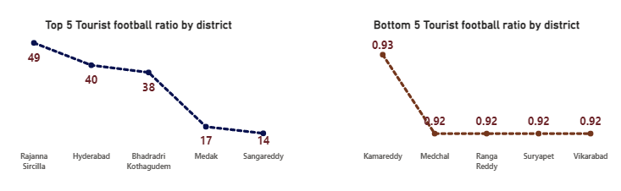
Question 6:
List the top and bottom 5 districts based on population to tourist football ratio in 2019.
Insights
Rajanna has the highest football ratio
Four District lie at the bottom ratio of about 0.92
The downfall is may be due to the lack of tourism attraction and infrastructure

Slide 13
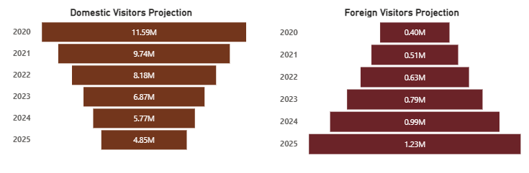
Question 7:
What will be the projected number of domestic and foreign tourist in Hyderabad in 2025 based on the growth are from previous years?
Insights
Domestic Visitors has the declining trend while Foreign Visitors has the increasing trend

Slide 14
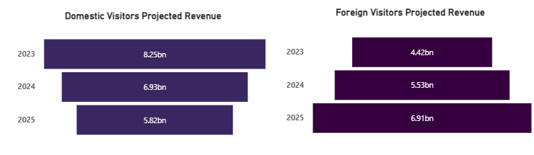
Question 8:
Estimate the projected revenue for domestic and foreign visitors for Hyderabad in 2025 based on average spend per tourist
Insights
Domestic Revenue Project is declining year on year while Foreign Revenue Projection is increasing year on year

Slide 15
Recommendations

Slide 16
Question:
Districts with highest potential
a.Which districts has the highest potential for tourism growth and what actions government can take
There are three main districts which has the highest potential
01
Warangal
Rich History and Landmarks
Promote Cultural Heritage
Invest in infrastructure and Tourism Activities
02
Adilabad
Scenery Location Like Kadam Dam
Invest in Recreational Activities
Invest in tourism startups and promote this place
03
Hyderabad
Huge potential , Big City
Invest in cultural Festivals
Facilitate visitors so they promote it further

Slide 17
Question:
Cultural/Corporate Events to boost tourism
a. What kind of events the government can conduct
b. Which months
c. Which districts
Events
Marathons
Cultural Festivals
Museum Exhibitions
1
Months
Summer Vacations
Months include May to September
Winter Vacations include December to February
Business Conferences Trend in Weekends at Quarter Closing
2
Districts
As already Discussed
Hyderabad
Adilabad
Warangal and Karimnagar due to cultural heritage
3

Slide 18
Question:
Dubai has made itself a business hub and enjoys massive business tourism.Can Hyderabad emulate the dubai model
Dubai
Dubai has huge infrastructure
Government is Stable
Dubai has Created may tourism Hubs
Hyderabad may be not become dubai but it can learn from the business model of Dubai
Hyderabad
Can Invest on Infrastructure
Promote International Scholarships and Exchange Programs
Conduct International Conferences on Hyderabad
Create Ease of Doing Business and Tourism Hubs

Slide 19
Question:
Provide all other recommendations that can boost the Telangana tourism,particularly Hyderabad
Promote Heritage Sites
01
Cultural Events and Festivals
Hospitality and Service Quality
Infrastructure Development
Develop Theme Parks:
Boost Tourism in Hyderabad
Enhance Infrastructure
03
02
Promote Culinary Tourism
Tourism Promotion
Collaborate with Government Agencies

Slide 20
Dashboard

Slide 21
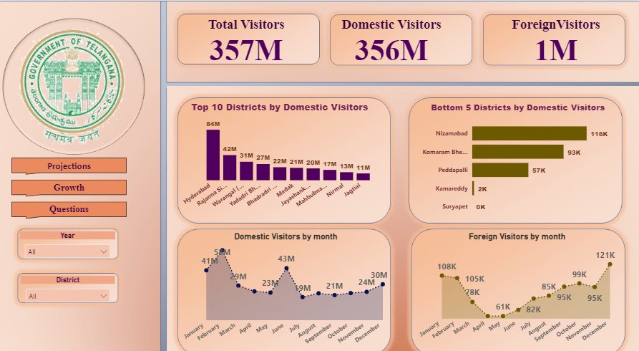

Slide 22
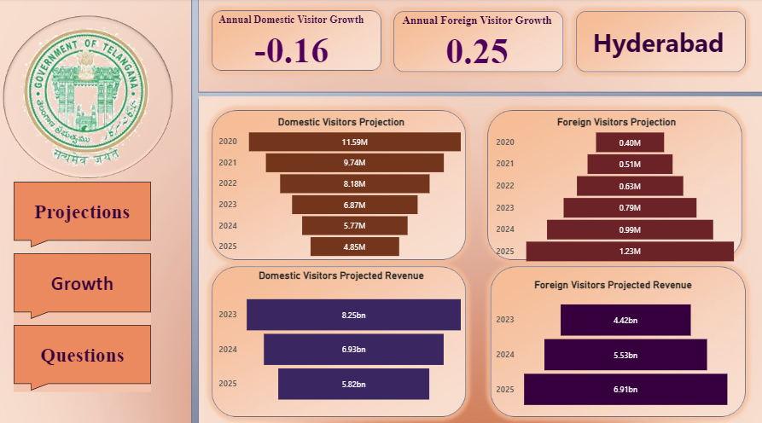

Slide 23
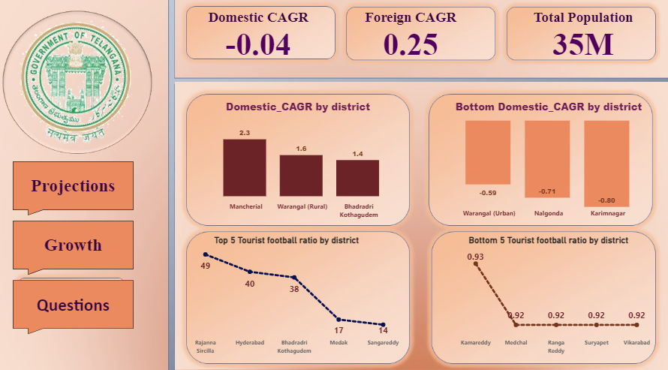

Slide 24
Thank You

